Slide 1
Quadcopters

Slide 2
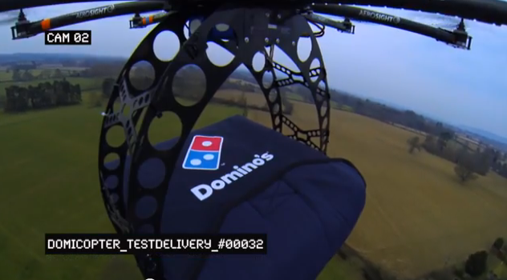
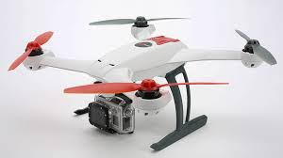
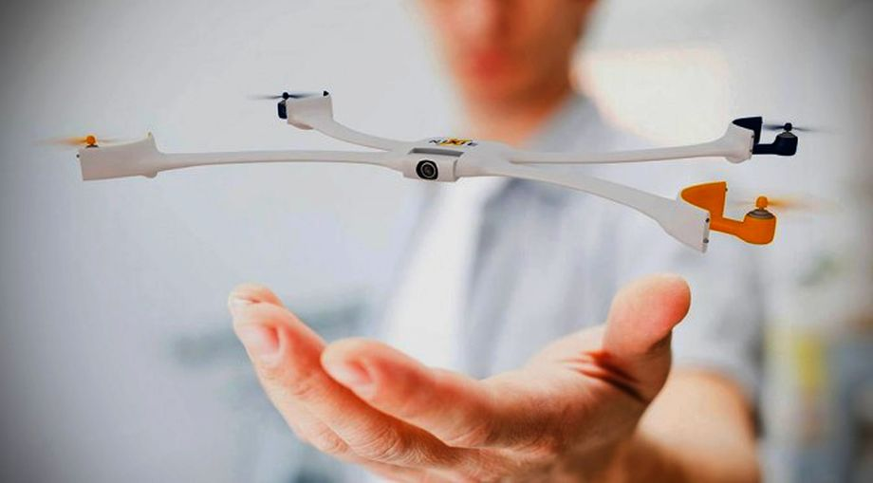
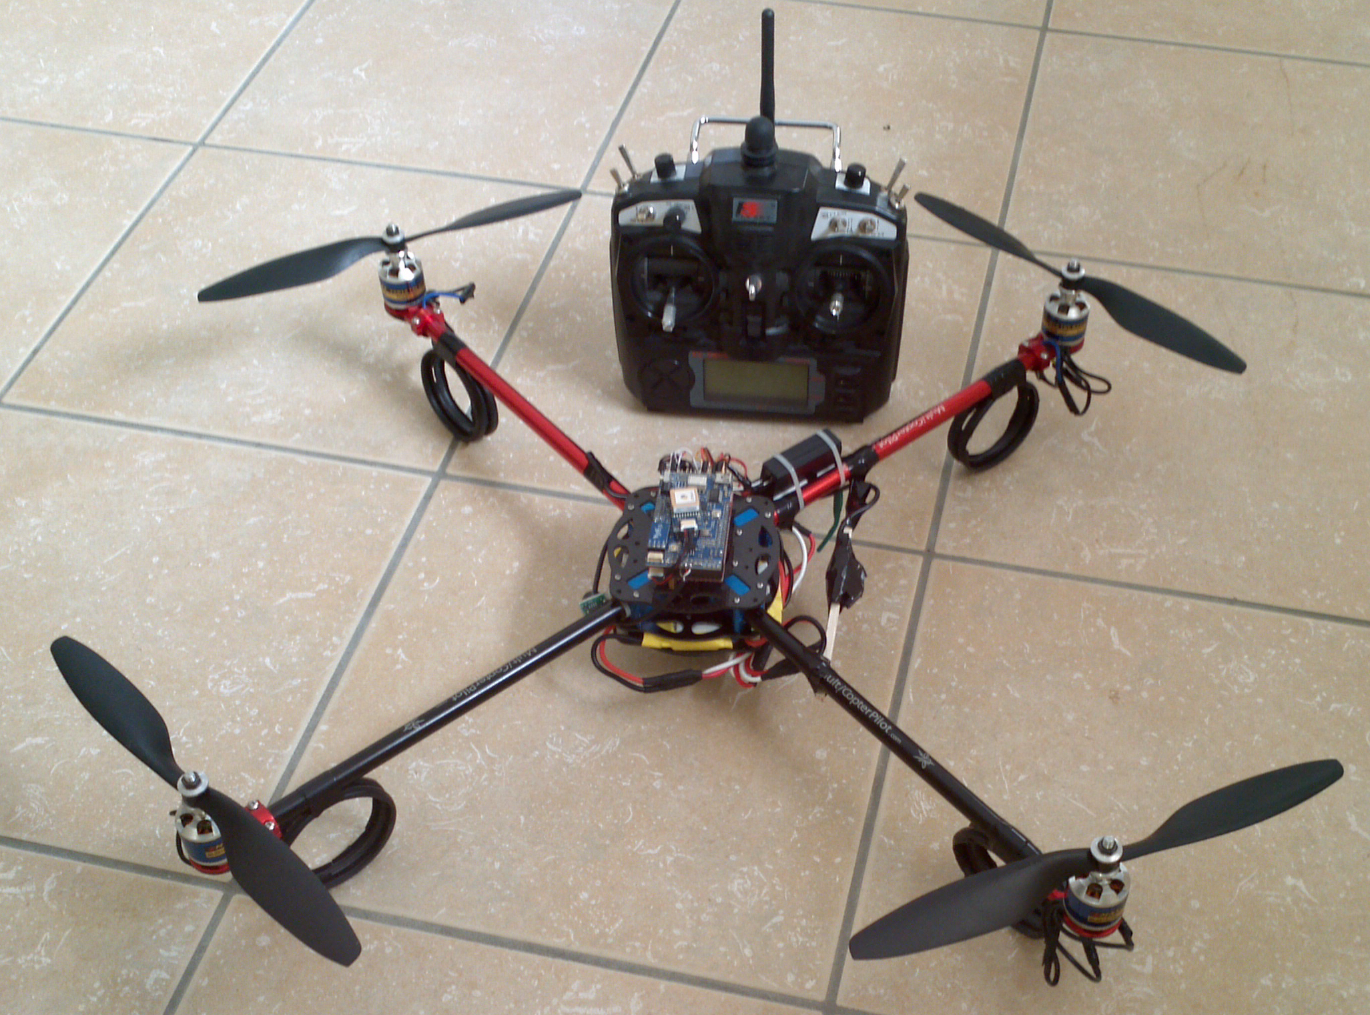
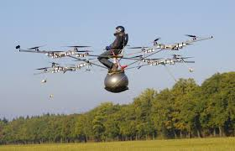
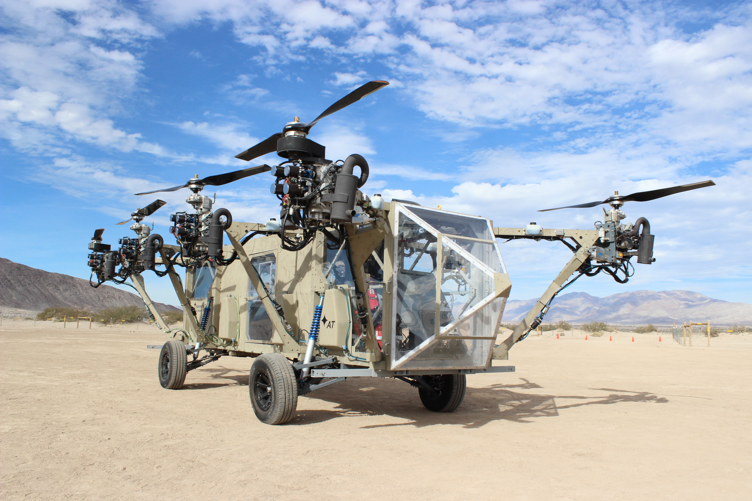
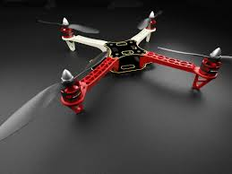
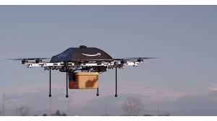
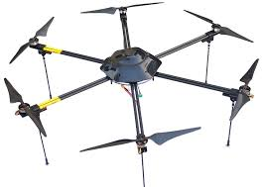

Slide 3
Multirotor Aircraft Components
Airframe
Structural support
Plastic, aluminum, wood, or PCB (fiberglass)
Motors
Lift, movement, and control
Brushed DC motors for small craft
Brushless brushless DC motors for large craft.
Inertial Measurement Unit (IMU)
Sensing the aircraft’s orientation and movement
Gyroscopes and accelerometers.
Computing resources (microcontroller/processor)
To run the flight control software
Manage communication
Flight control software
Provides stability using the IMU and motors
Converts pilot commands to motor outputs
Radio
For receiving command
Returning telemetry.
Power supply
Lots of power for the motors
Carefully regulated power for the IMU and micro controller.

Slide 4
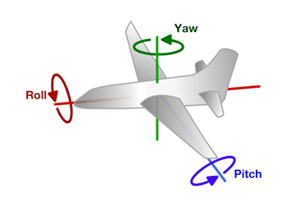
Principles of Operation (1)
An even number of motors provides lift and control in 6 dimensions
Spatial dimensions: x, y, z
Pitch: rotation around left-right (y) axis
Roll: rotation around the front-back (x) axis
Yaw: rotation around the top-bottom (z) axis
A flight computer operates a closed-loop controller to maintain stability and implement pilot commands.
Z
X
Y

Slide 5
Controlling Pitch
Pitch forward
More thrust to the rear
Less to the front
Pitch backward
Less thrust to the rear
More to the back

Slide 6
Controlling Roll
Pitch Left
More thrust to the right motor
Less to the left
Pitch Right
More thrust to the left motor
Less to the Right

Slide 7
Controlling Yaw
Rotate CCW
More thrust to the CCW motors
Less to the CW
Rotate CW
More thrust CW motors
Less to the CCW

Slide 8
Some Possible Configurations
Hexa +
Hexa x
“Plus”
“X”
Octa +
Octa x
“Octothorpe”
Y 6

Slide 9
Maintaining Stability
Multi-rotor aircraft are inherently unstable
Mismatched motor power (voltage variation, manufacturing variation in motors or props)
Variation in air currents and density.
Once perturbed, there’s no force acting on the aircraft to return it to equilibrium.

Slide 10
Maintaining Stability
Multi-rotor aircraft require a closed loop controller
Sensors detect aircraft movement and orientation
Controller adjusts the power to motors to maintain desired location and orientation
Multi-rotor aircraft use a few sensors to maintain stability
Accelerometers (absolute pitch and roll)
Gyroscopes (changes in pitch, roll, and yaw)
The flight computer implements the control algorithm
Usually a proportional, integral, derivative (PID) controller implemented in software.
We will talk more about this later.
With PID controllers for pitch, yaw, and roll multirotor aircraft can achieve stable flight.

Slide 11
Higher-order Navigation
Large multi-rotor aircraft can do more
Maintain geographic position
Maintain altitude
Follow an prescribed/pre-programmed path
More sensors required
Magnetometers (absolute yaw or heading)
GPS (absolute location and altitude)
Barometers (altitude)

